Slide 1
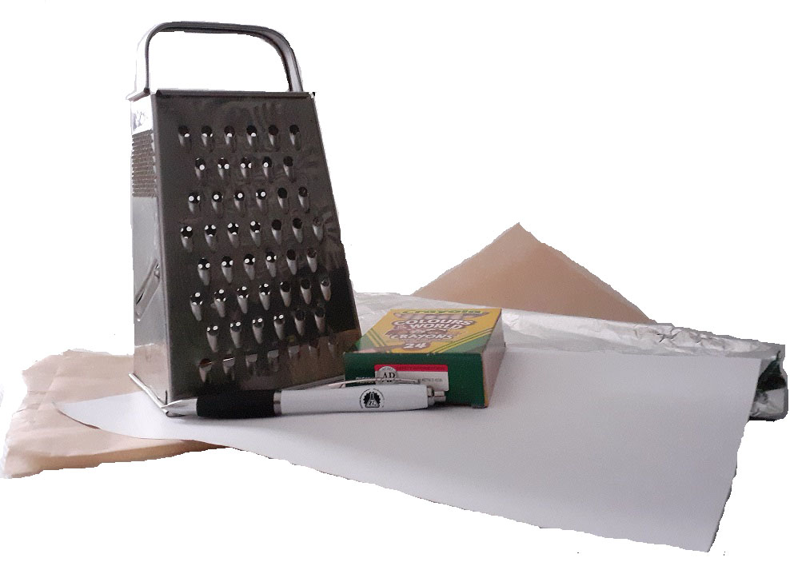


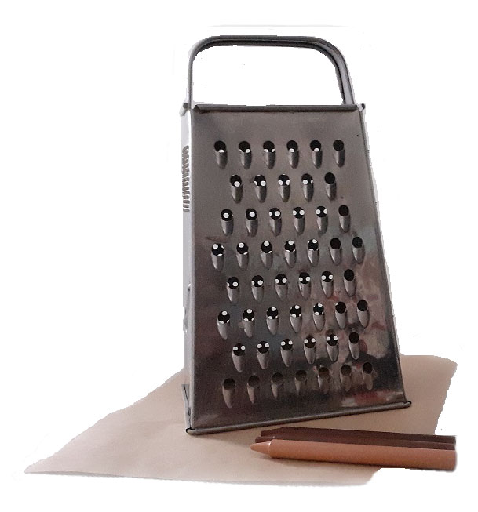
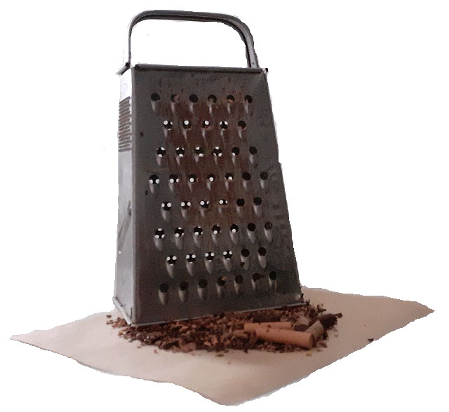
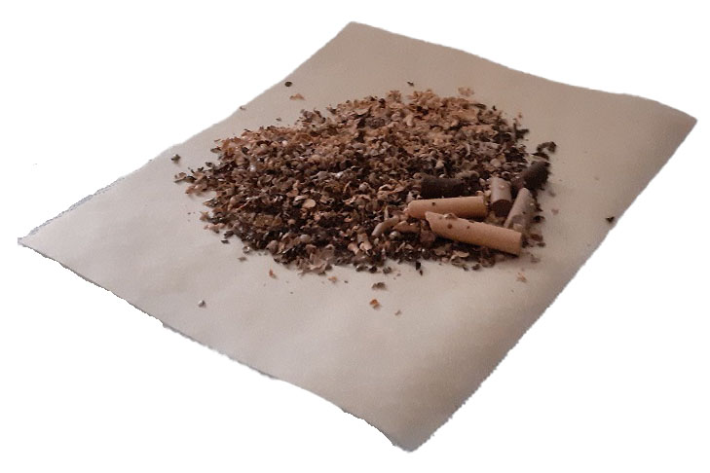
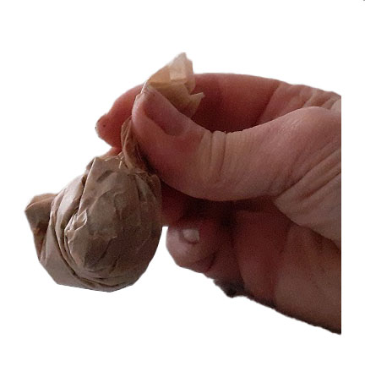

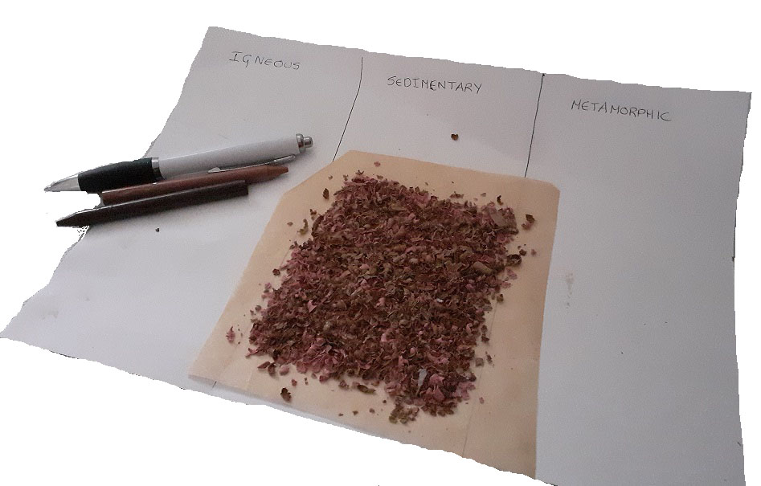


Crayon Rocks
Give your old crayons a new lease of life whilst you investigate
the rock cycle.
What you need
• Crayons • Cheese grater • Pencil and paper • Wax paper • Foil
1.
Draw three columns of your piece of paper and label these i) Igneous, ii) Sedimentary and iii) Metamorphic.
3.
Peel the paper off three different coloured crayons. Place your grater on top of wax paper and carefully grate the crayons – mix up the gratings. These gratings are like sedimentary rock. Describe what it looks and feels like. Place a little of the grated crayon on another piece of wax paper and put this on the 2nd column.
4.
Pick up the wax paper with the larger pile of crayon grating on it. Fold the wax paper over the top and twist to compress it into a ball. Grab the ball and squeeze tight to squash the crayon together. This pressure and heat from your palm are similar to what happens in the earth. Now we have a metamorphic rock. If your hands are cold put the compressed packet on a warm radiator for 5 to 10 minutes.​
2.
Peel the paper off a few crayons. Unwrapped
crayons are like igneous rocks. Feel and look at the crayons then write a few words in the igneous column to describe these. Lay two crayons on the bottom of the column as an example.

Slide 2
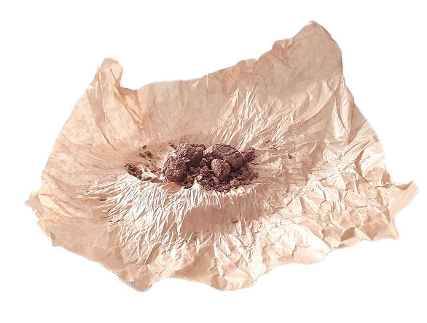
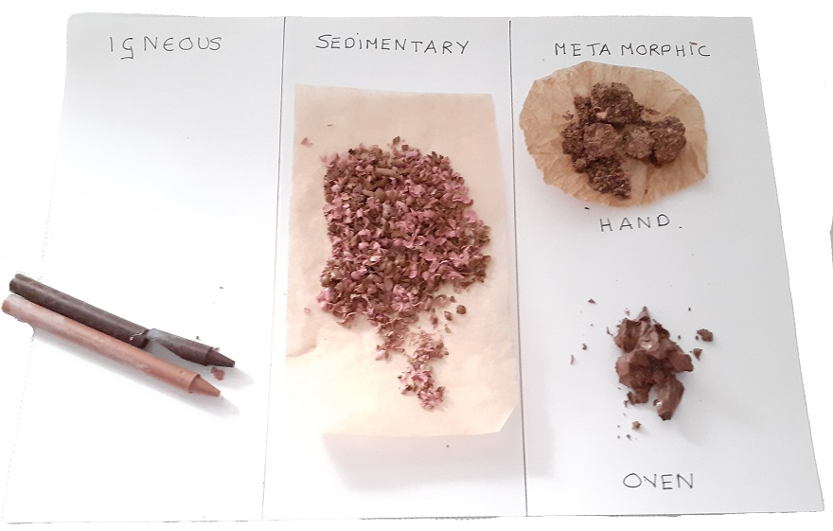
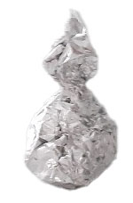
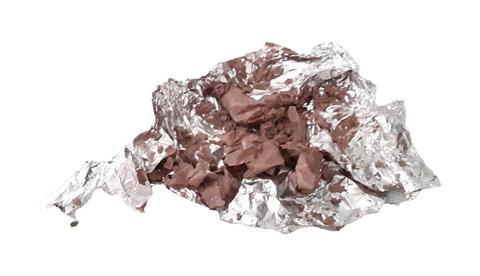

6
5.
6.
7.
Open the wax paper and write down in the third column what the crayon looks and feels like. Place the ‘rock’ on to the metamorphic column. Write ‘HAND’ beside it.
OPTIONAL EXTRA. Requires adult assistance.
Look at your paper holding your ‘rock' samples. Can you notice any differences?
Repeat the grating of the crayon and pour onto a piece of foil. Scrunch the foil around the crayon applying some pressure. Ask an
adult to put the foil wrapped crayon into a preheated oven (230ºC for 2-3 minutes).
Take it out and let the wax cool before opening the foil and laying in its column.​ Write ‘Oven’ beside it. Now you have metamorphic rock in a new shape as it has melted and cooled down.​
The Science
What is the rock cycle?
The earth's rocks do not stay the same forever. The rock cycle is the process by which rocks change from one kind to another.
There are three main types of rocks:
igneous (for example, basalt and granite)
sedimentary (for example, limestone and sandstone)
metamorphic (for example, slate and marble)
Rocks are continually changing because of ongoing processes such as weathering, erosion, exposure to heat or pressure and earth movements. Rocks change type, for example when sedimentary rock is buried under the earth, because of earth movements, it becomes exposed to pressure (from the weight above) and might be exposed to heat and changes into metamorphic rock.
Alternatively, rocks can be gradually worn away and changed by a process called weathering. There are three types of weathering; biological, chemical, and physical.
Biological weathering is caused by animals, plants and even humans. This cause rocks to split or erode when constantly damaged through interactions.
The weathering of rocks by chemicals is called chemical weathering. Rain is naturally slightly acidic because carbon dioxide is dissolved in it. This then eats at the face of the rock and causes surface damage and erosion. Different rocks are affected in different ways, for example limestone and chalk containing large quantities of calcium carbonate undergo a chemical reaction when exposed to ‘acidic rain’ and large quantities of the rock can be washed away.
Physical weathering is caused by physical processes, for example temperature, wind, waves. Changes in temperature can cause rocks to expand or contract leading to cracking. Over time this can cause significant damage and lead to rocks splitting.

